Slide 1
Data-Science PROJECT
PREDICTING THE GDP MOVEMENT TRENDS OF VARIOUS COUNTRIES AND SUGGESTING INVESTEMENT IN OUR NEW COUNTRY
Team members:
Rohit Khokle
Madhava Peddisetti
Pranatha Rao

Slide 2
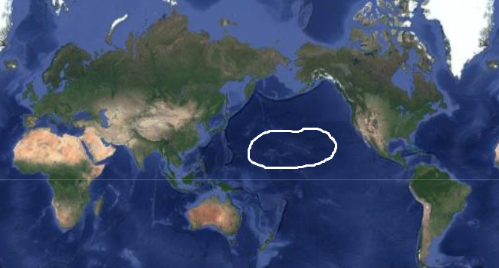
PREFACE
Republic of Data-stan is a newly formed island country formed in middle of Pacific.
Its east coast neighbors are USA, Canada and west coast neighbors are Russia, Japan and Philippines and some coast of China

Slide 3
PROBLEM STATEMENT
To maximize our new country - Republic of Data-stan ‘s National growth (GDP), we look at how other countries have fared and how their investment in certain sections have impacted their GDP.
Analyzing GDP movement trends of various countries (USA, China, Germany, UK, France, India) based on access, spending, and years of Education, Healthcare, Research & Development, FDI, ODA (Official Development Assistance), Employment in service, Literacy and its effect on National Income (over the years).
We are performing this analysis on several countries over last 2 decades.

Slide 4
MAJOR SECTORS CONTRIBUTING TO GDP
We focus on increasing our Nation’s income in the following ways:
1) Investment in Education: We analyze the top countries in Education and how it affects their GDP
2) Investment in Quality Healthcare: Identify countries with good quality healthcare, how it affects the quality of life and find the correlation with services/economy.
3) Investment in R&D: Identify countries with good quality investment in R&D, how it affects the quality of life and find the correlation with services/economy.
4) ODA (Official Development Assistance): Identify countries with good quality in Official Development Assistance, how it affects the quality of life and find the correlation with services/economy.

Slide 5
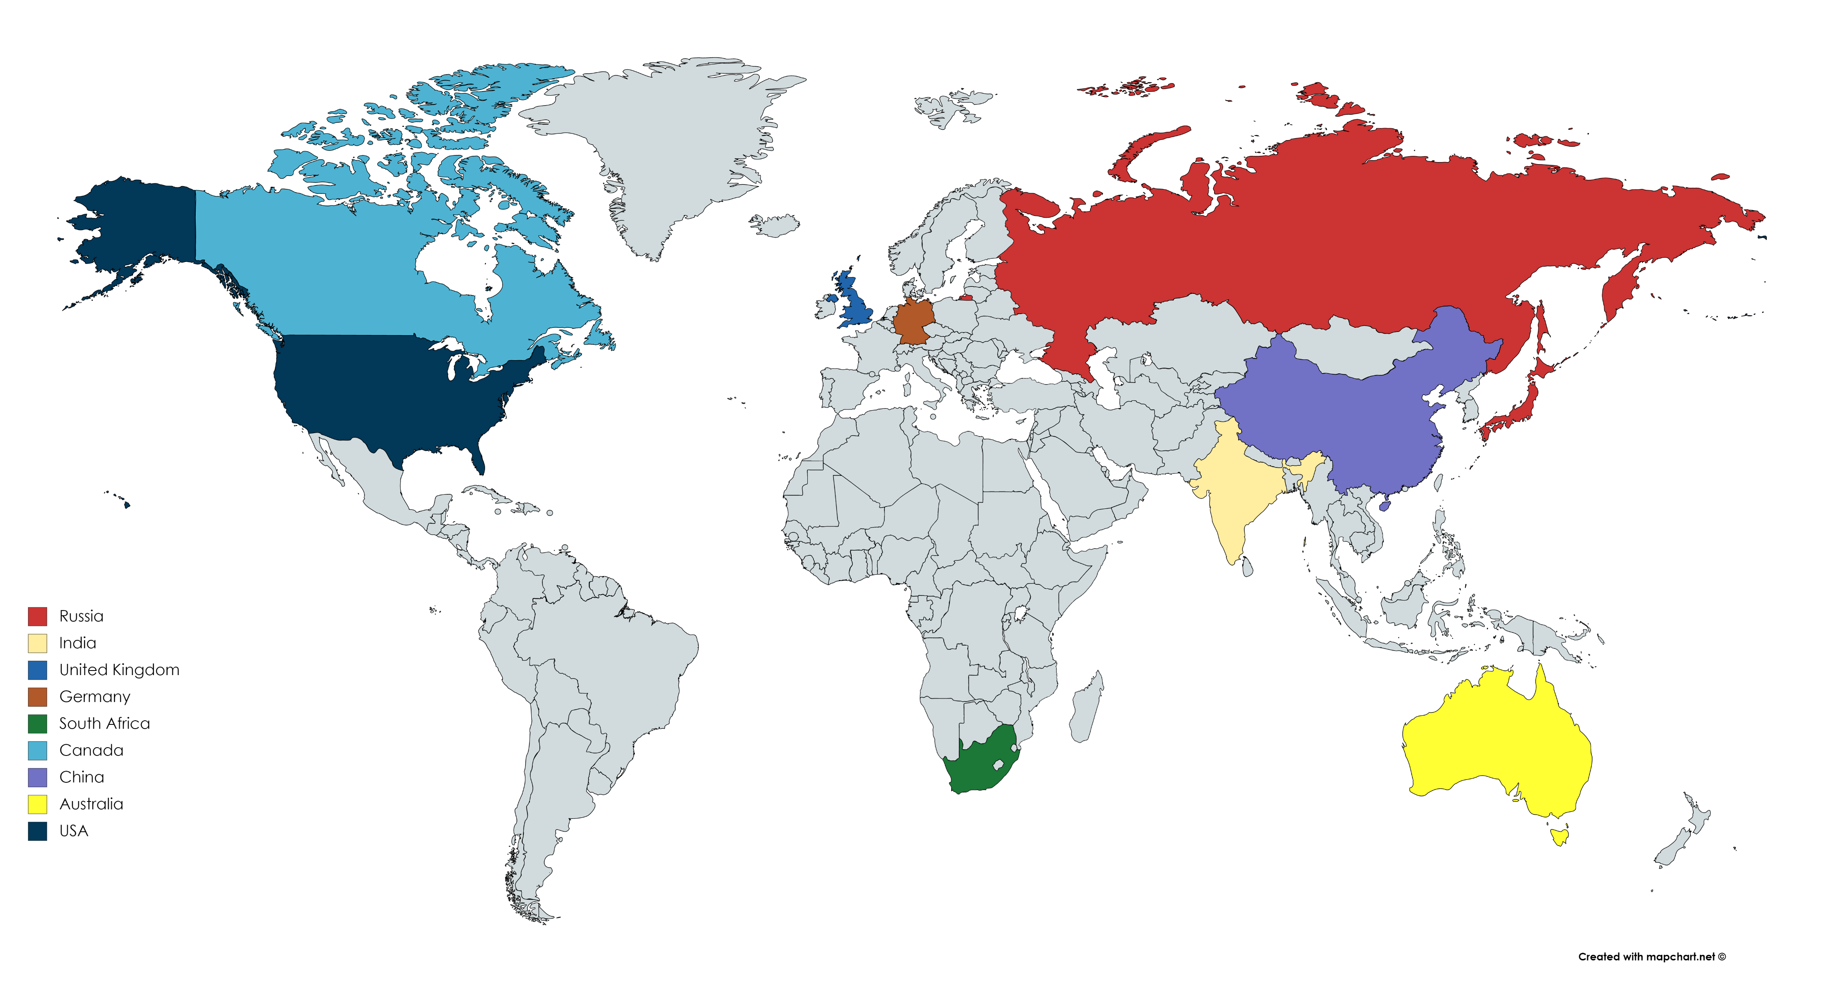
Countries that we are focusing on:

Slide 6
APPROACH
We focus on increasing our Nation’s income in the following ways:
1) Datasets: UNESCO datasets, WorldBank Dataset (using wbdata library)
2) Analysis: We performed analysis using OLS regression.
Independent variables : various expenditure sections (Education, Healthcare, etc)
Dependent variable : GDP of the country
3) Modelling: Random Forrest, OLS Linear Regression, Artificial Neural Network

Slide 7
IMPLEMENTATION
1) Pick Country: We pick one country and get its GDP, its expenditure on various sections over past 2 decades. Each row represents the performance and expenditure of that country.
2) EDA: We perform EDA and shift GDP column by a few rows. So now each row we can correspond the expenditure column to the future GDP
3) P-value Stats : Now we perform p-value statistics (using OLS) and see if there is any effect of the independent variables to the GDP.
4) Modelling: We train the model using the data, and give analysis and if we take the same approach how the projected growth will be using Linear Regression, Random Forest and Artificial Neural Network

Slide 8
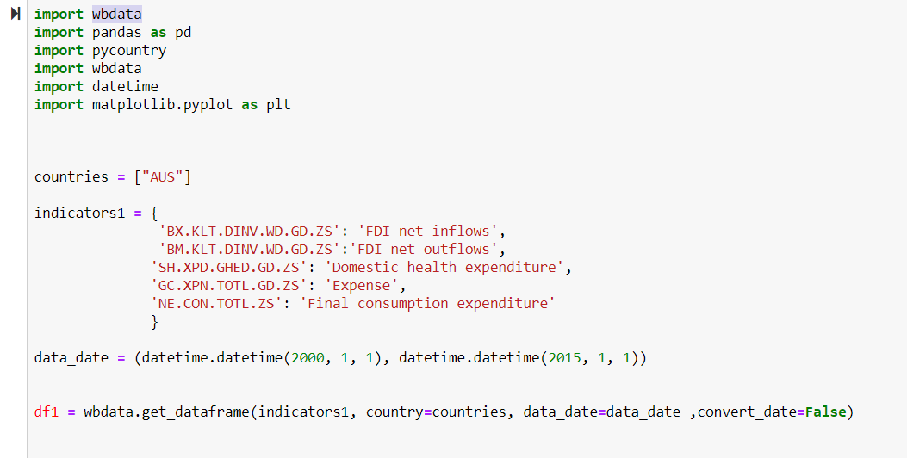
Code snippets in following slides:
Fetching the data through various indicators using World Bank API

Slide 9
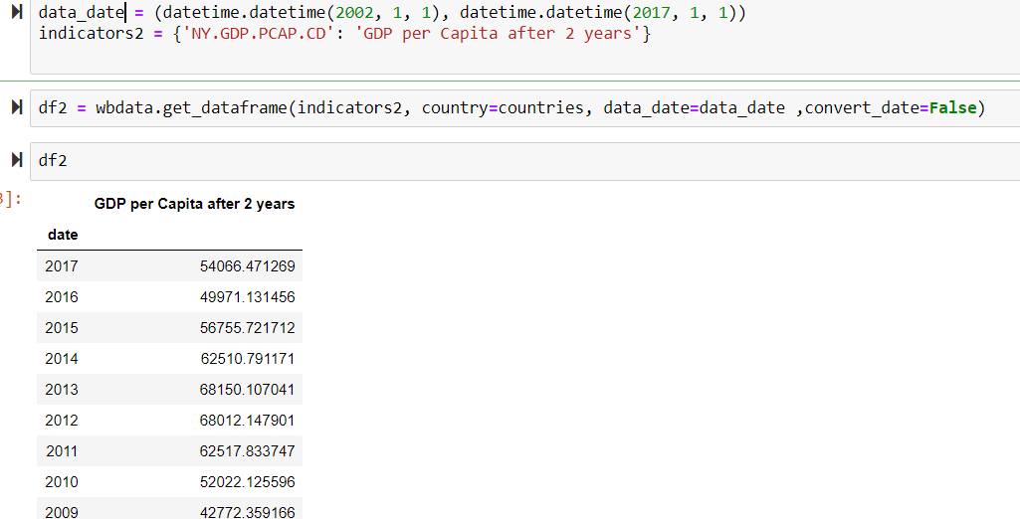
GDP of the country, 2 years ahead.

Slide 10
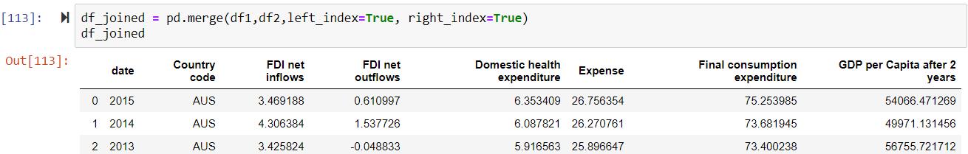
Merge the ‘Future’ GDP to the dataframe

Slide 11
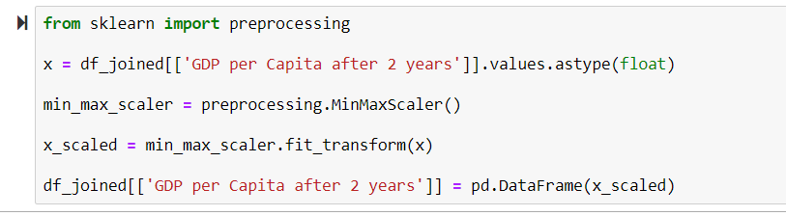
Preprocessing (as the units are different)

Slide 12
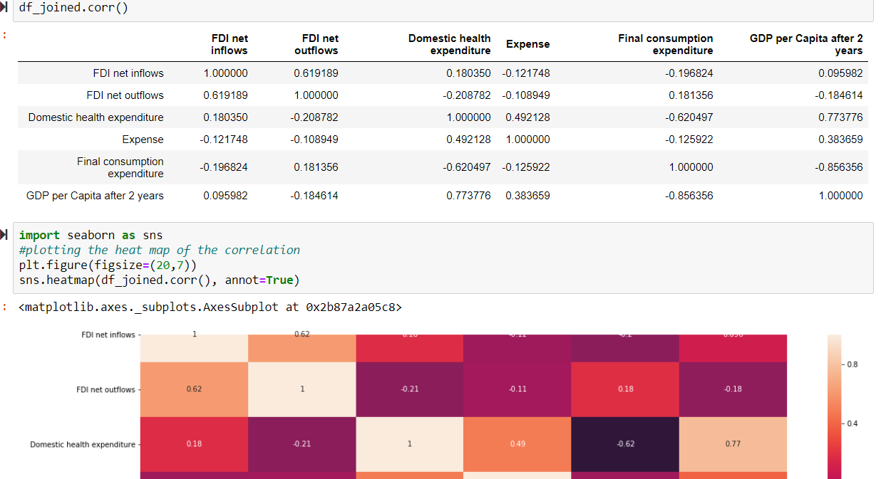
Correlation and HeatMap

Slide 13
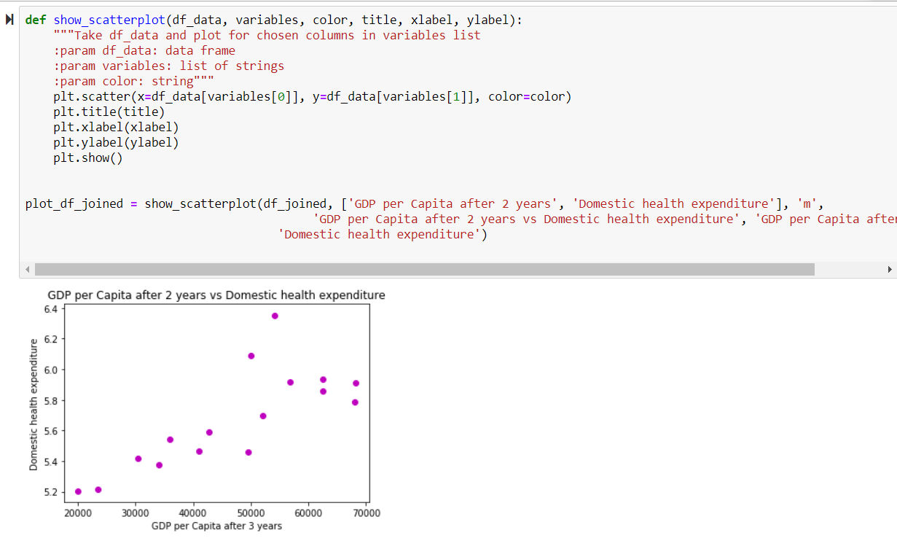

Slide 14

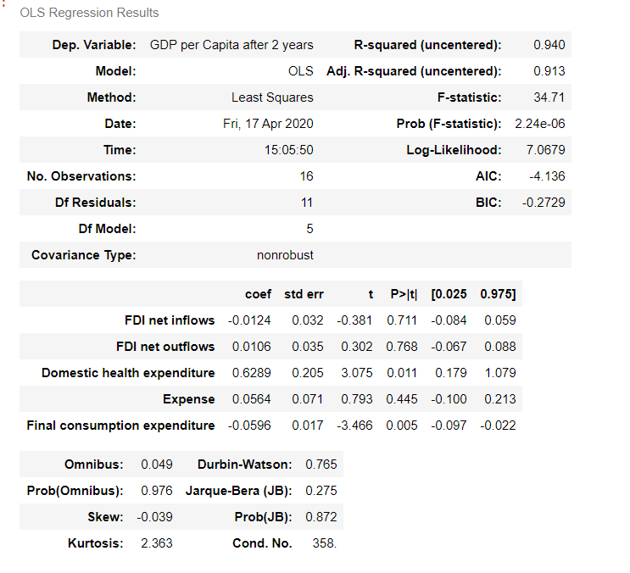
OLS result. (Trail. We will be adding more parameters here, and shift the GDP years as well)

Slide 15
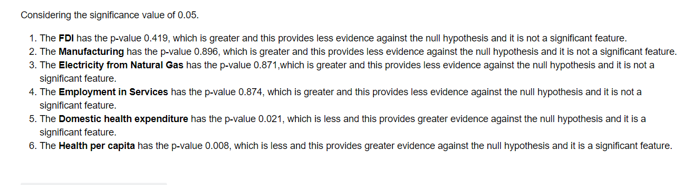

Slide 16
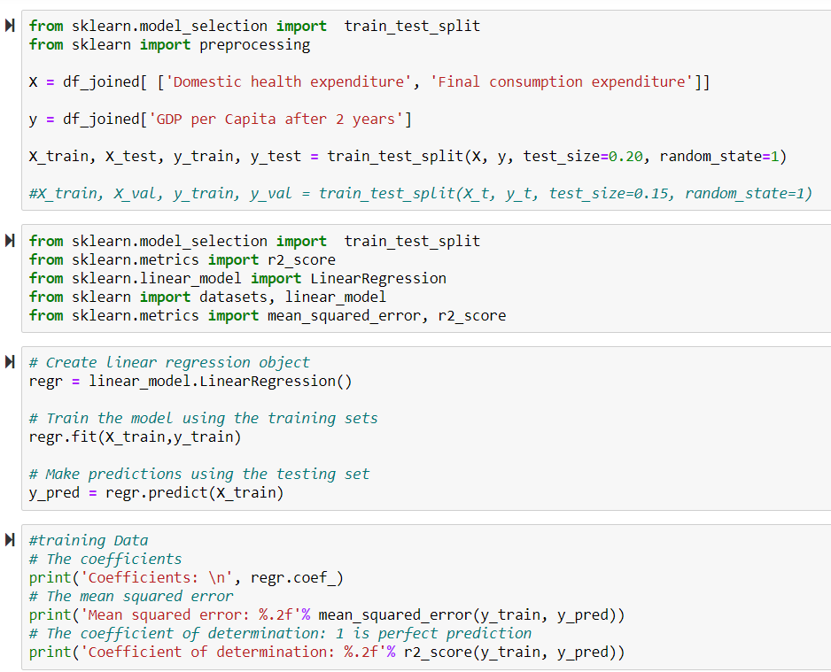
Linear Regression

Slide 17
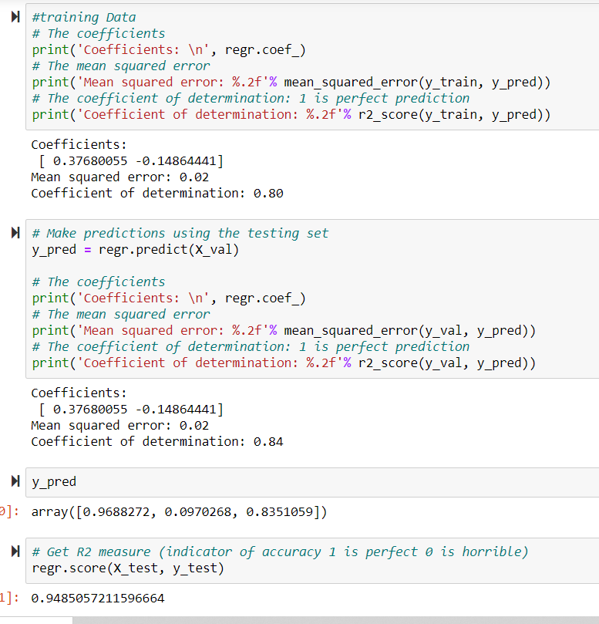

Slide 18
Project Comment
The above results were for Australia. We plan to implement the same for other countries
We also plan to add ANN Modelling
In Education investment, we assume that the impact will be seen 5 years/decade later, so will have separate analysis for the same (A different notebook)
Citations
https://towardsdatascience.com/is-there-a-relationship-between-countries-wealth-or-spending-on-schooling-and-its-students-a9feb669be8c
http://www.oecd.org/economy/growth/18450995.pdf
https://data.oecd.org/
https://databank.worldbank.org/indicator/NE.EXP.GNFS.ZS/1ff4a498/Popular-Indicators

